Slide 1



Revolutionizing Parking Ericiency: Harnessing the Power ofIoT for
Smart Parking
Solutions

Slide 2
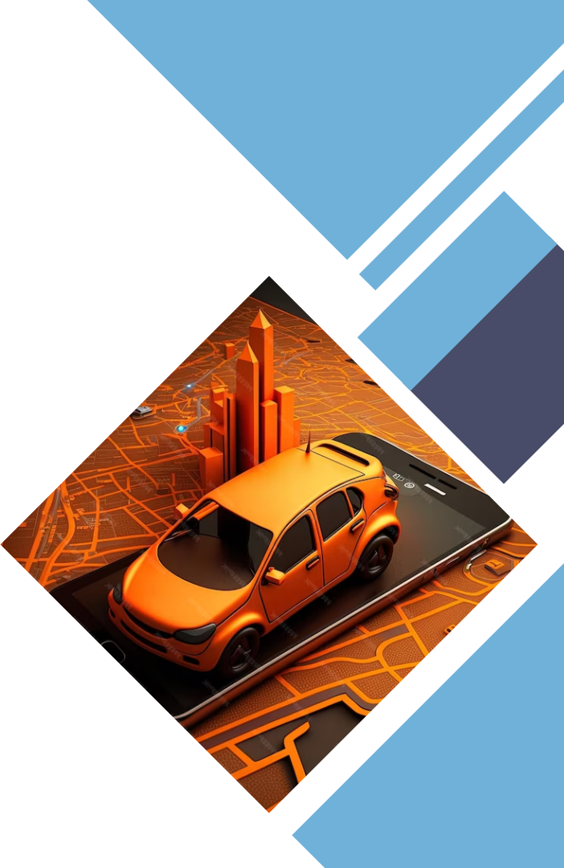

Introduction
Welcome to the revolution of parking efﬁciency! In this presentation, we will explore how the Internet ofThings (IoT) is transforming parking solutions. Discover the power of IoT in optimizing parking spaces, reducing congestion, and enhancing user experience. Get ready to delve into the world of smart parking!

Slide 3
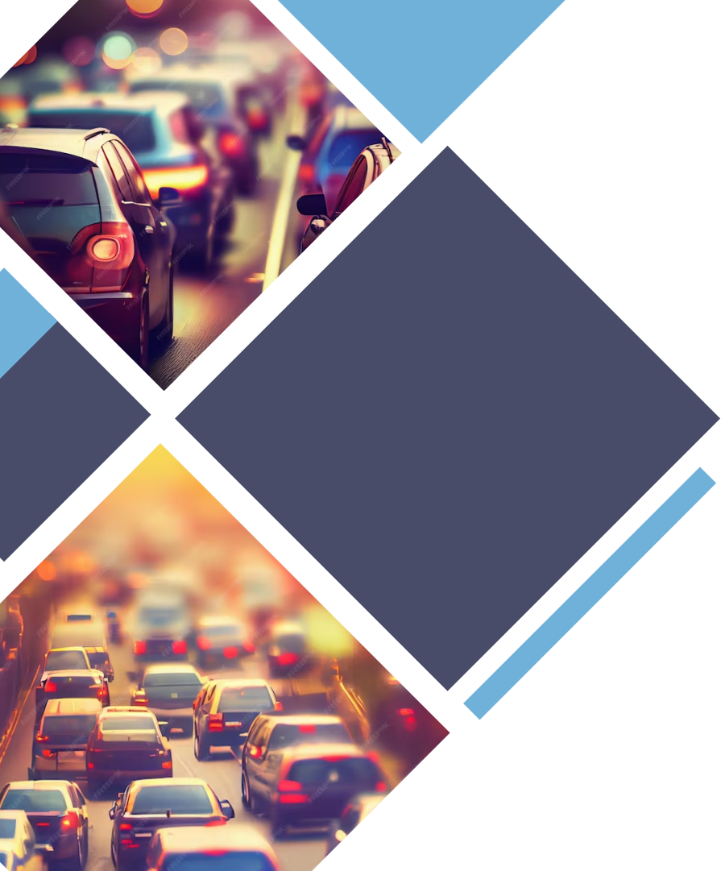
Current Parking Challenges
Parking congestion, inefﬁcient utilization of
spaces, and frustrated drivers are common
problems in urban areas. Traditional parking
systems lack real-time information and smart management. IoToffers a solution by enabling real-time monitoring, intelligent parking
guidance, and seamless payment mechanisms. Let's explore how IoT can revolutionize parking efﬁciency.

Slide 4
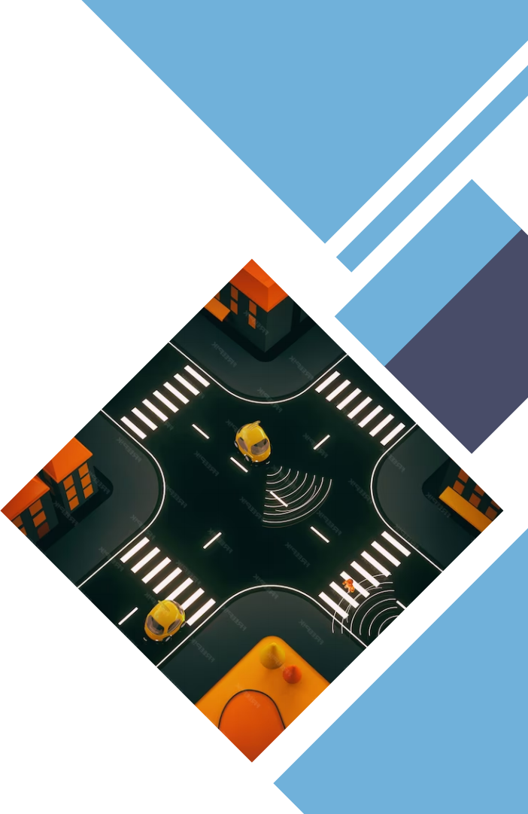
IoT and Smart Parking
By leveraging IoTtechnology, parking becomes smarter and more efﬁcient. Connected sensors and devices provide real-time data on available parking spaces, allowing drivers to ﬁnd vacant spots effortlessly. Smart parking solutions also enable automated payment systems, reducing the hassle of manual transactions. Let's dive deeper into the components of IoT-enabled smart parking.

Slide 5
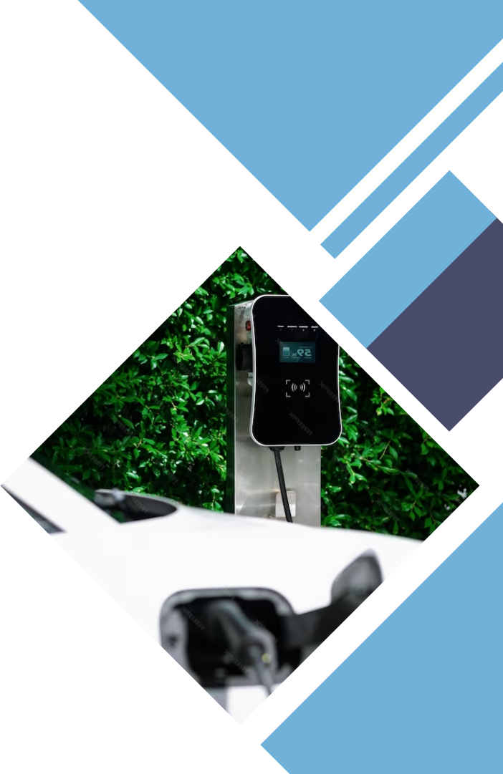
Sensors and Data Collection
Sensors play a crucial role in smart parking solutions. They detect the presence or absence of vehicles in parking spaces, transmitting data to a central system. Real- timedata on parking occupancy enables efﬁcient management, accurate guidance, and predictive analytics. With IoT, parking operators can make data-driven decisions to optimize parking resources and enhance overall efﬁciency.

Slide 6

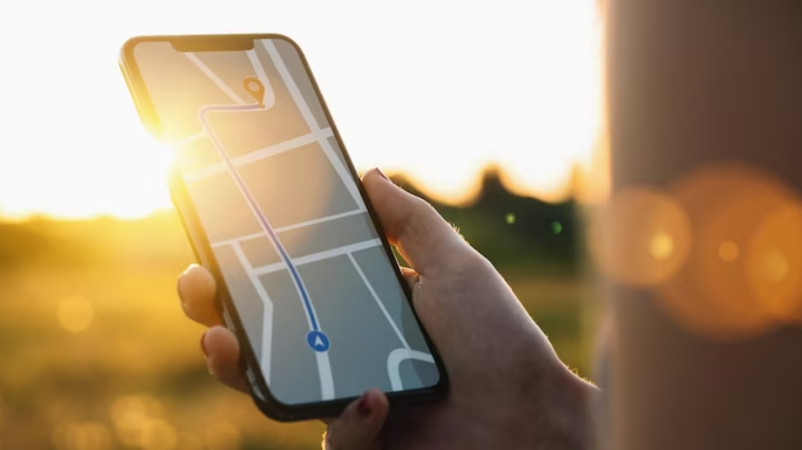
Intelligent Parking Guidance
Finding an available parking spot can be frustrating. Intelligentparkingguidance systems use IoT data to direct drivers to vacant spaces quickly. Mobile apps, digital signage, and in-car navigation systems provide real-time guidance, reducing search time and trafﬁc congestion. With IoT-enabled guidance, drivers can have a stress-free parking experience.

Slide 7

Seamless Payment Mechanisms
Traditional parking payment methods often involve manual transactions and long queues. IoT-enabledsmart parking solutions offer seamless payment mechanisms. Integrated mobile payment apps and automatic billing systems make the payment process convenient and efﬁcient. By eliminating the need for physical tickets or cash, IoT simpliﬁes the parking payment experience for both drivers and parking operators.

Slide 8
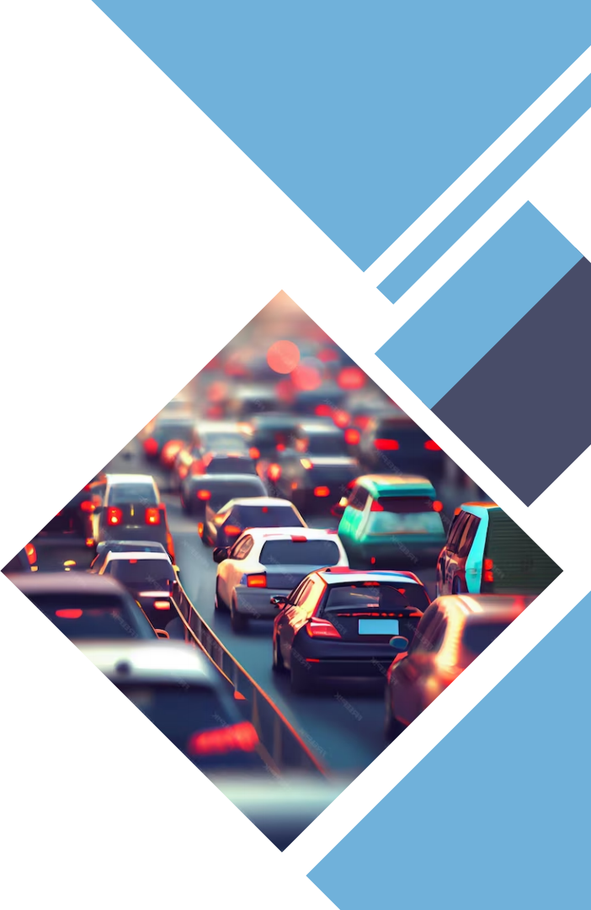
Beneits ofIoT in Parking
The adoption of IoT for smart parking brings numerous beneﬁts. It optimizes parking space utilization, reduces trafﬁc congestion, and enhances user experience. Drivers save time and fuel by quickly ﬁnding parking spots, while parking operators gain insights for efﬁcient resource allocation. With IoT, revolutionize parking efﬁciency and create a seamless parking ecosystem.

Slide 9



Conclusion
In conclusion, IoT-driven smart parking solutions have the
potential to revolutionize parking efﬁciency. By leveraging
real-time data, intelligent guidance, and seamless payment
mechanisms, IoT transforms traditional parking systems
into smart, user-friendly experiences. Embrace the power
of IoT and unlock the full potential of smart parking
solutions for a more efﬁcient and convenient future.

Slide 10

Thanks!

